Slide 1
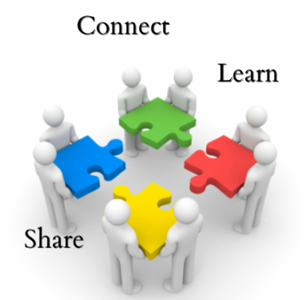
Engaging the Disengaged
Engagement
Welcome
Connect
Learn
Share
Wrap Up

Slide 2
Engaging the Disengaged
Engagement
1. Take a card and write out a student, scenario, or past experience where you had a student who was disengaged. Write your name on the other side of the card.
2. What did you do to reengage them?
3. Who did you turn to for help?
4. What was the end result?
Welcome
Connect
Learn
Share
Wrap Up

Slide 3
Engaging the Disengaged
Engagement
Welcome
LEARNING
Connect
Other students know me and value me
Why am I here?
Where are we going?
Learn
My teacher knows me and values me
GOALS
Share
RELATIONSHIPS
PURPOSE
Wrap Up
FOUNDATION

Slide 4
Engaging the Disengaged
Engagement
Welcome
LEARNING
Connect
VOICE
Learn
STUDENTS
INPUT
PURPOSE
Share
OWNERSHIP
Wrap Up
FOUNDATION

Slide 5
SELF-ASSESSMENT
TEACHER ASSESSMENT
PEER ASSESSMENT
Engaging the Disengaged
Engagement
Welcome
LEARNING
Connect
Learn
Share
RELATIONSHIPS
PURPOSE
Wrap Up
FOUNDATION

Slide 6
Engaging the Disengaged
Engagement
STRATEGIES
Welcome
LEARNING
Connect
VOICE
Learn
STUDENTS
INPUT
PURPOSE
Share
OWNERSHIP
Wrap Up
FOUNDATION

Slide 7
Brain Chain
Engaging the Disengaged
Engagement
STRATEGIES
Stand up in your groups: Topic: Shoe Brands
Welcome
LEARNING
Connect
VOICE
Learn
STUDENTS
INPUT
PURPOSE
Share
OWNERSHIP
Wrap Up
FOUNDATION

Slide 8
Connect Nine
Engaging the Disengaged
Engagement
STRATEGIES
Topic: Elk Grove
Welcome
LEARNING
Connect
VOICE
Learn
STUDENTS
INPUT
PURPOSE
Share
OWNERSHIP
Wrap Up
FOUNDATION

Slide 9
Connect Nine
Engaging the Disengaged
Engagement
STRATEGIES
Topic: Elk Grove
Welcome
LEARNING
Connect
Grens | Mascot | Paul
Funny | Turf | Nancy
Tough | Incredible | Billing Cycle
VOICE
Learn
STUDENTS
INPUT
PURPOSE
Share
OWNERSHIP
Wrap Up
FOUNDATION

