Slide 1
7.4 She’ll Play Ball
Vocabulary

Slide 2
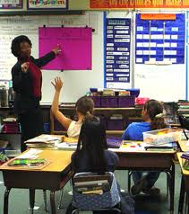
instructional

Slide 3
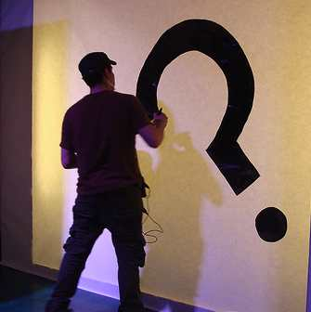
unpredictable

Slide 4
contract

Slide 5
pointers

Slide 6
debut

Slide 7
edge

Slide 14
Tips; advice
POINTERS

Slide 15
Legal agreement between people
CONTRACT

Slide 16
First appearance or time
DEBUT

Slide 17
advantage
EDGE

Slide 18
Related to teaching
INSTRUCTIONAL

Slide 19
Difficult to guess at or predict
UNPREDICTABLE

